Slide 1
Design Patterns
Observer Patterns

Slide 2
Weather Monitoring Application
Weather Station which monitors humidity, temperature, and pressure.
There are three different displays for showing the information from the Weather Station
  Current Conditions
  Weather Stats
  Forecast
Goal:
  Changes in the Weather Station must update all three displays.
  In addition, need capability to add additional displays in the future.

Slide 3
Observer Pattern
GoF Intent: “Defines a one-to-many dependency between objects so that when one object changes state, all of its dependents are notified and updated automatically.”
pgs 38-56 provide a good background on the pattern.

Slide 4
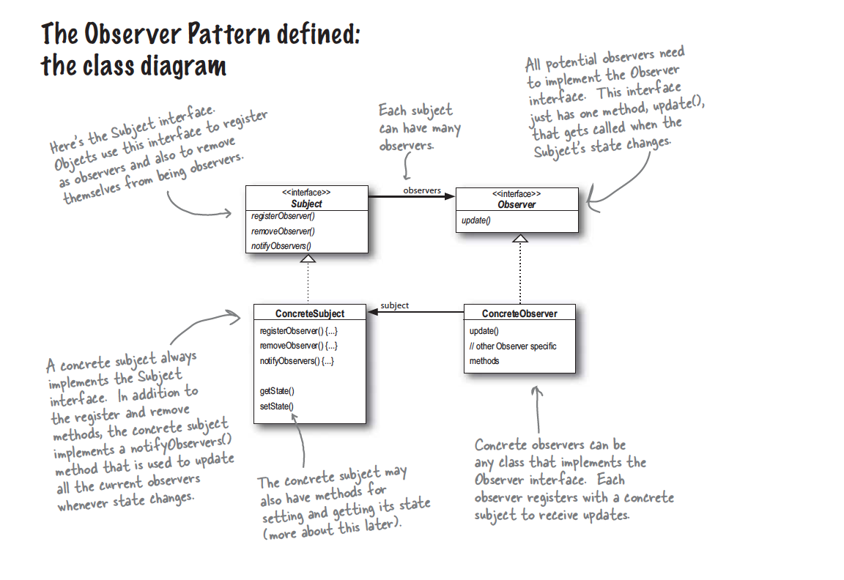

Slide 5
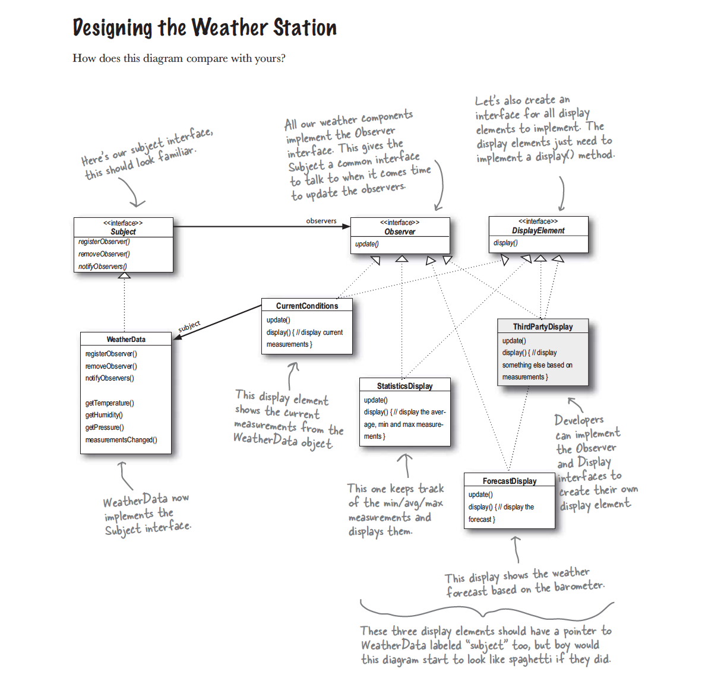

Slide 6
Definitions
Subject
  Sends a notification message to one or many observers when there is a change in state.
  Along with the message, provides information on the state that has changed.
Observers – The objects that want to be notified about changes in the Subject’s state

Slide 7
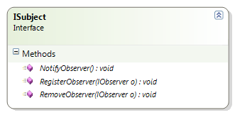
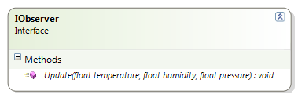
Interfaces
Contains signatures for registering, removing, and notifying observers.
Contains Update method so that information can be sent from Subject to Observer.

Slide 8
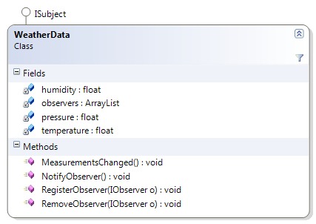
WeatherData (Subject)
The fields for humidity, pressure, and temperature represent the state of the Subject.
Notes:
Questions:
Which field is used for storing the list of Observers?
How does an Observer add itself to this list?

Slide 9
WeatherData (Subject; Pt 1)
public class WeatherData : ISubject {
//Fields that represent State
private float temperature;
private float humidity;
private float pressure;
public void SetMeasurements(float temperature,
float humidity, float pressure) {
//Not Shown: set field variables based on parameters
MeasurementsChanged();
}
public void MeasurementsChanged() {
NotifyObserver();
}
}
Observers are notified since state has changed.

Slide 10
WeatherData (Subject; Pt2)
public WeatherData() {
observers = new ArrayList();
}
public void RegisterObserver(IObserver o) {
observers.Add(o);
}
public void RemoveObserver(IObserver o) {
int i = observers.IndexOf(o);
if(i >= 0) observers.Remove(o);
}
public void NotifyObserver() {
foreach(IObserver observer in observers) observer.Update(temperature,humidity,pressure);
}
Here is how the Subject sends information to all Observers

Slide 11
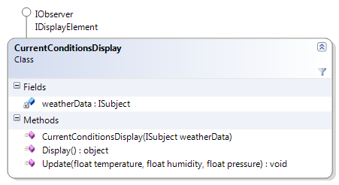
Current Conditions Display (Observer)
Note that the individual Observer is composed of the Subject.
So the Subjects has a reference to all Observers…and each Observer has a reference to a Subject.
Questions:
What method on this Observer is called by the Subject when data is changed?

Slide 12
CurrentConditionsDisplay (Observer)
public class CurrentConditionsDisplay : IObserver, IDisplayElement {
private ISubject weatherData;
public CurrentConditionsDisplay(ISubject weatherData)
{
this.weatherData = weatherData;
weatherData.RegisterObserver(this);
}
public void Update(float temperature, float humidity, float pressure)
{
//Store information so that it can be displayed
//This class contains its own version of the 3
//state variables.
}
}

Slide 13
WeatherStation
//Create Subject
WeatherData weatherdata = new WeatherData();
//Create Observer
CurrentConditionsDisplay currentDisplay = new CurrentConditionsDisplay(weatherdata);
//Create Observer
StatisticsDisplay statDisplay = new StatisticsDisplay(weatherdata);
weatherdata.SetMeasurements(80, 65, 30.4f);
weatherdata.SetMeasurements(82, 70, 29.2f);

Slide 14
Lab - Push
public void NotifyObserver() {
foreach(IObserver observer in observers)
observer.Update(temperature,humidity,pressure);
}
This is called a “Push” model because the Subject is “pushing” information to the Observer(s).
Question 1: What happens if we need to add a 4th state variable? Is there another alternative to sending all of these state variables?
Question 2: In general, should we push state by reference or by value?
Question 3: The three state variables in this example are rather simple (three strings). Let’s say they are actually more complex objects that take up a lot of memory. The Subject only changes one state variable. What problem may we have? How can we resolve it?
Notes:
Interface breaks.
By value. The Observer needs to have it’s own version of the state data.
Problem is that the Subject sends a lot more information that needed. We can resolve by sending a null value for data that has not changed.

Slide 15
Lab - Pull
An alternative to the “Push” model is the “Pull” model. The Observer pulls the information that is needed from the Subject. We can make a simple change to the IObserver interface:
public interface IObserver {
void Update(ISubject subject);
}
Question 1: A specific Observer using this interface would need to query the Subject to get specific information about that Subject. Can we use the ISubject interface?
Notes:
No. We would need to cast the subject to a specific subject so that we can get the properties that we want. This ties our Observer to a very specific Subject. Note with the Push model, the Observer did not need to know about the Subject data.
Question 2: Let’s say CurrentConditionsDisplay gets notified that WeatherData has a change. It goes to retrieve the new temperature…but right before it does, WeatherData gets another temperature change and is reset to the original temperature value. Does the Observer notice any real change? How can we resolve?

Slide 16
Lab – Refactor WeatherData
When class resumes, we will be going through a major refactoring of the WeatherData example in the book. Please consider these question in preparation for this exercise:
Look at WeatherData example on pg58. Which pieces of information is really specific to Weather? Which part is specific to the whole Subject/Observer relationship?
Look at CurrentConditionsDisplay on pg 59. Which pieces is specific to Weather? To the Subject/Observer relationship?

Slide 17
Refactoring WeatherData
We want to create an infrastructure so that we can reuse Subject and Observer functionality.
Also, according to the Single Responsibility Principle, the class WeatherData is doing too much!
What two general options can we consider to break this object up?

Slide 18
Subject
Let’s create an abstract class called “Subject” with some default implementation. (We will also create a class “Observer” that also has some default implementation).
Looking at the WeatherData (pg58), which methods in WeatherData should be moved to Subject?
Which fields should be moved to Subject?
What should the constructor of Subject initialize?
Notes:
1. reigsterObserver
removeObserver
notifyObservers
2. ArrayList observers
3. Initialize the ArrayList of observers

Slide 19
Subject
public abstract class Subject {
private List<Observer> observers;
public Subject() {
observers = new List<Observer>(); }
public void RegisterObserver(Observer o) { .. }
public void RemoveObserver(Observer o) { .. }
public void NotifyObserver()
{
foreach (Observer observer in observers)
observer.Update(temperature, humidity, pressure);
}
}
What is wrong with NotifyObserver??
Notes:
Temperature, humidity, and pressure aren’t part of a generic subject.

Slide 20
Subject
public abstract class Subject {
private List<Observer> observers;
public Subject() {
observers = new List<Observer>();
}
public void RegisterObserver(Observer o) { }
public void RemoveObserver(Observer o) { }
public void NotifyObserver()
{
foreach (Observer observer in observers)
observer.Update(this);
}
}
Notes:
Is this implying Push or Pull?

Slide 21
Observer
Looking at CurrentConditionsDisplay (pg59), we should abstract out the registering of the Observer to a Subject.
  What kind of argument do we need to pass in the Observer constructor?
  Within the Observer constructor, what method should we call on the Subject?
  How can we enforce that the inherited classes use this constructor??
What method should Observer provide?

Slide 22
Observer
public abstract class Observer {
public Observer(Subject subject)
{
subject.RegisterObserver(this);
}
private Observer() { }
public abstract void Update(Subject subject);
}

Slide 23
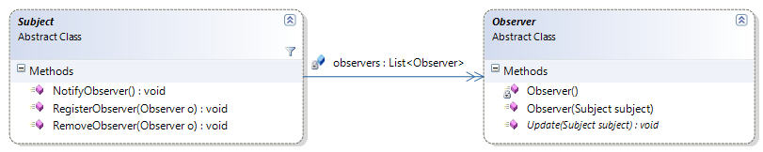
So far…
Observer registers itself with the Subject
NotifyObserver will loop through each Observer and call Update() and pass a reference of itself

Slide 24
Concrete Subject
What class should WeatherData inherit from?
How will the Observer get information from our Concrete Subject??
  Remember: We are using Pull model. Hint on previous Pull slide..
How will WeatherData tell the Observers that there is an update?

Slide 25
ConcreteSubject
public class WeatherData : Subject {
//Not Shown: the three fields
public float getTemp() { return this.temperature; }
public float getHumidity() { return this.humidity; }
public float getPressure() { return this.pressure; }
public void SetMeasurements(…) {
//Set data here
measurementsChanged(); //which calls NotifyObservers
}
}

Slide 26
Concrete Observer
What data needs to be passed in the Constructor?
How will Update get access to the specific properties for the Subject??

Slide 27
ConcreteObserver
public class CurrentConditionsDisplay : Observer, IDisplayElement {
private WeatherData weather;
//Fields Not shown
public CurrentConditionsDisplay(WeatherData wd) : base(wd) {
this.weather = wd;
}
public override void Update(Subject subject) {
if (subject == this.weather)
{
this.temperature = this.weather.getTemp();
this.humidity = this.weather.getHumidity();
this.pressure = this.weather.getPressure();
}
}
}

Slide 28
Client Code
//Create Subject
WeatherData weatherdata = new WeatherData();
//Create Observers (with reference to Subject)
CurrentConditionsDisplay currentDisplay = new CurrentConditionsDisplay(weatherdata);
ForcastDisplay forcastDisplay = new ForcastDisplay(weatherdata);
//Tell Subject to change state
weatherdata.SetMeasurements(80, 65, 30.4f);

Slide 29
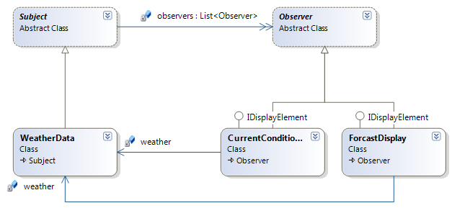
The Big Picture

Slide 30
In Class Lab
Our Subject class has one Update function that is called when there is a change in state. But what if we want our Subject to have multiple Update functions? For example, one Update function could represent a change in state for fields A, B, and C. Another Update function could represent a change in state for fields X, Y, and Z.
Question 1: Will our current implementation of Subject support multiple update events?
Question 2: What if we just add another Update() function to Subject? What is the problem with that?
Question 3: Consider this..are our Observers interested in the Subject itself..or in an actual event notifying change?

Slide 31
Multiple Events
Currently, the Observers want to be notified when there is a change in the weather measurements(Temperature, Humidity, Pressure).
The Subject (WeatherData) now gets the capability to store information about the probability of a disaster occurring. This is defined by:
  float HurricaneProbability
  float TornadoProbability
The Subject needs two notification events:
  WeatherMeasureChanged
  DisasterProbabiltyChanged

Slide 32
Problem
The Subject (WeatherData) only has one notification event. We have a one-to-one relationship between Subject and Event.
We need a one-to-many relationship. One Subject can have one or more events!

Slide 33
Analysis
Our current Subject has a one-to-many relationship with Observers.
Subject ← Observer1
← Observer2
← Observer3
A subject has one event. So we can think about this as:
Subject → Event ← Observer1
← Observer2
← Observer3

Slide 34
Analysis
We would like our Subject to contain multiple events.
Subject → Event1
→ Event2
→ Event3
Therefore, we need a structure like the following:
Subject → Event1
← Observer1
← Observer2
→ Event2
← Observer1
← Observer3

Slide 35
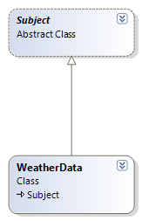
Subject (Current Implementation)
Our Subject class contains the one notification event.
Our ConcreteSubject gets the notification event by inheritance.
We want our ConcreteSubject to contain multiple events. Does Inheritance make sense??? Would could we use instead?

Slide 36

Subject/SubjectEvent
This class represents a specific event of the Subject.

Slide 37
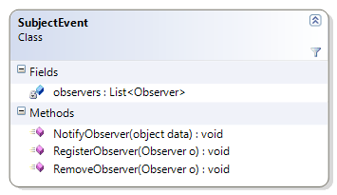
SubjectEvent
Now the SubjectEvent, not Subject, contains a reference to all of the Observers who are interested in being notified.

Slide 38
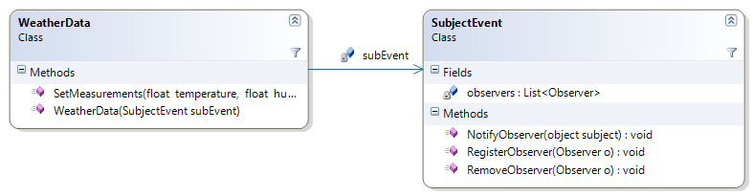
Subject/SubjectEvent
The constructor of WeatherData takes a SubjectEvent as parameter.

Slide 39
WeatherData
public class WeatherData {
private SubjectEvent subEvent;
public WeatherData(SubjectEvent subEvent) {
this.subEvent = subEvent;
}
public void SetMeasurements(…)
{
this.temperature = temperature;
this.humidity = humidity;
this.pressure = pressure;
this.subEvent.NotifyObserver(this);
}
}

Slide 40
SubjectEvent + Observers
In our prior design, what information did the Subject pass on to the Observers?
In this design, should the SubjectEvent pass the same information to the Observers?
What if an Observer is listening to two different events on the same Subject? The Observer will want to know which data to pull based on the Event that notified it.
  So, what does the SubjectEvent also need to tell the Observers who are listening to it?
Notes:
The Subject passed on a reference to itself.
The SubjectEvent needs to pass the Subject as well.
The SubjectEvent needs to tell the Observer the name of the event.

Slide 41
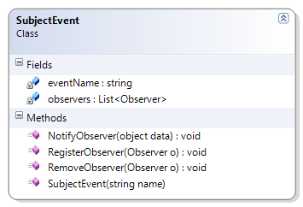
SubjectEvent
Added name parameter to the constructor and storing it in eventName Field.

Slide 42
SubjectEvent
public class SubjectEvent {
private List<Observer> observers;
private string eventName;
public SubjectEvent(string name) {
observers = new List<Observer>();
eventName = name;
}
public void NotifyObserver(object subject) {
foreach (Observer observer in observers)
observer.Update(subject, eventName);
}
}
Cheating

Slide 43
Observer
In the prior design, the Observer was constructed with a reference to the Subject. In this design, what should we pass in the constructor instead?
What should the signature of the Update() function look like?

Slide 44
Observer
public abstract class Observer {
public Observer(SubjectEvent subEvent) {
subEvent.RegisterObserver(this);
}
public abstract void Update(object data,
string eventName);
private Observer() { }
}

Slide 45
CurrentConditionsDisplay
public override void Update(object data, string name) {
if (data is WeatherData) {
WeatherData weather = (WeatherData)data;
if (name.Equals("WeatherChanged"))
{
this.temperature = weather.getTemp();
this.humidity = weather.getHumidity();
this.pressure = weather.getPressure();
}
}
}
}

Slide 46
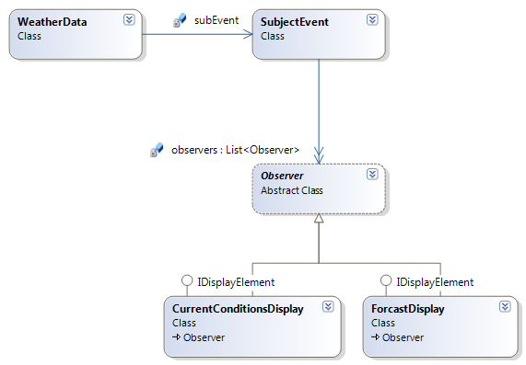
Big Picture

Slide 47
Client Code
//Create SubjectEvent..with specific event name
SubjectEvent event1 = new SubjectEvent("WeatherChanged");
//Create Observers for that event
CurrentConditionsDisplay observer1 = new CurrentConditionsDisplay(event1);
ForcastDisplay observer2 = new ForcastDisplay(event1);
//Create Subject (and pass in reference to the event)
WeatherData subject = new WeatherData(event1);

Slide 48
Not done yet..
WeatherData just contains one event. Now we want to add a second event.
public class WeatherData {
SubjectEvent weatherEvent;
SubjectEvent disasterEvent;
public WeatherData(SubjectEvent weatherEvent, SubjectEvent disasterEvent) {
this.weatherEvent = weatherEvent;
this.disasterEvent = disasterEvent;
}
}

Slide 49
WeatherData (cont)
public void WeatherMeasurementsChanged()
{
this.weatherEvent.NotifyObserver(this);
}
public void DisasterProbabilityChanged()
{
this.disasterEvent.NotifyObserver(this);
}

Slide 50
ConcreteObserver
public override void Update(object data, string name) {
if (data is WeatherData)
{
WeatherData weather = (WeatherData)data;
if (name.Equals("WeatherChanged"))
{ //do weather stuff }
else if (name.Equals("DisasterComing"))
{
this.hurricaneProbability = weather.getHurricaneProb();
this.tornadoProbability = weather.getTornadoProb();
}
}
}

Slide 51
Client Code
//Create Observers
CurrentConditionsDisplay observer1 = new CurrentConditionsDisplay();
ForcastDisplay observer2 = new ForcastDisplay();
//Create SubjectEvents
SubjectEvent se1 = new SubjectEvent("WeatherChanged");
se1.RegisterObserver(observer1);
se1.RegisterObserver(observer2);
SubjectEvent se2 = new SubjectEvent("DisasterComing");
se2.RegisterObserver(observer2);
//Create Subject
WeatherData wd = new WeatherData(se1, se2)

Slide 52
Other Problems Arise..
Problem #1: Let’s say CurrentConditionsDisplay gets notified that WeatherData has a change in temperature. It then performs some magical actions, which result in WeatherData getting another change in temperature. What is the impact?
Problem #2: WeatherData objects are created for VA, MD, and DC regions. The Observers should only be updated when all three WeatherData objects have an internal change.

Slide 53
Change Manager
Both of these problems can be solved with another objected called the ChangeManager.
This object is an example of Mediator Pattern
  GoF Intent: “Define an object that encapsulates how a set of objects interact. Mediator promotes loose coupling by keeping objects from referring to each other explicitly, and it lets you vary their interaction independently.”
It can handle complex update strategies.
It can also be a Singleton!

Slide 54
Features of the Change Manager
Contains a mapping of Subject-to-Observers.
Provides an interface for registering Subject to Observers.
Eliminates the need for Subject to maintain references to its Observers (and vica versa).
Defines a specific update strategy.

Slide 55
Addressing Problem #2
ChangeManager can store the relationship between each Subject to Observers. For example:
  Subject : WeatherData (DC)
  Observer(s): CurrentConditions, ForcastDisplay
  Subject : WeatherData (VA)
  Observer(s): CurrentConditions
  Subject : WeatherData (MD)
  Observer(s): CurrentConditions, StatisticsDisplay

Slide 56
Addressing Problem #2 (cont)
When WeatherData(DC) has an internal update, it sends a message to ChangeManager to notify observers.
The ChangeManager contains an internal state that indicates if all three WeatherData objects have indicated a recent change.
If ChangeManager determines that all three WeatherData objects have indicted a change, it sends a message to each Observer associated with each Subject.

Slide 57
Using Event Infrastructure
All of these examples have been using the Classical Definition of the Observer pattern.
There are language specific features of C# and Java that can be used to make this pattern much simpler to use.
Using the Event infrastructure:
  RegisterObserver → Register Event with Handler
  RemoveObserver → Unregister Event with Handler
  NotifyObserver → Raise Event
  Special data about the Event can be passed as Event argument.

Slide 58
Real World Examples
Problem #1
  Search screen that lists documents with a Status per document
  From the screen, user can open one or more documents.
  When a document is opened, the status is changed.
  User closes document, the search screen still displays the old status.
Who are the Observers?
Who are the Subjects?
Notes:
Observer = Search Screen. Just one observer
Multiple Subjects

Slide 59
Solution #1
Search Screen = Observer (Just one)
Each opened document = Subject
So we have one Observer with multiple Subjects.
When a document is opened, the Search screen (Observer) must register itself with the Document (Subject).
Subject must broadcast a notify message when its Status state changes.
Observer, upon receiving the message, can update its state and display the updated status.
When Subject closes, the Observer must unregister itself with the Subject. (The Subject needs to tell the Observer that it is closing)

Slide 60
Problem #2
Document structure that contains Parent and Child nodes.
When a Parent Node changes, all of the Child Nodes need to be re-validated.
Currently, we simply re-validate all Child Nodes for all Parents. There is no direct relationship between a change in Parent affecting the Child Nodes.
Who are Observers? Subjects?
Notes:
Observers = Each Child Node
Subject = Parent Node

Slide 61
Solution #2
Observers – All Child Nodes for a single Parent
Subject – Single Parent Node
So multiple Observers with one Subject.
All Observers must register themselves with a data change event for the Subject.
When the Subject changes it state, a data change notification is sent.
Each Subject re-validates itself.
Also: See Composite Pattern.

